Slide 1
IBM University Engagement Project Submission
“Exploring the Power of Agentic AI with IBM Granite and LangFlow”

Slide 2

Project Tile – 2. Agentic AI for Mental Health Awareness & Suicide Prevention
Domain of Project –Healthcare
Student Name | Recent Passport Photo | Email ID | Mobile number [WhatsApp]
Vasundhara Uchhula |  | vasundhara.uchhula@scet.ac.in | 9558297114

Slide 3
Problem Statement -
Problem Statement No.2: Agentic AI for Mental Health Awareness &
Suicide Prevention
The Challenge
Mental health issues such as depression, anxiety, and suicidal thoughts are growing worldwide. Stigma, lack of awareness, and limited access to timely help prevent many individuals from seeking support. Traditional systems are often reactive, leaving gaps in early detection and preventive care.
The Objective
Build an Agentic AI-powered Mental Health Awareness & Suicide Prevention Agent that is empathetic, proactive, and safe. The solution should:
1. Promote Awareness & Education – Share accessible resources on mindfulness, coping
strategies, and self-care.
2. Enable Early Detection (RAG) – Use Retrieval-Augmented Generation to identify distress signals in conversations, journaling inputs, or safe online data.
3. Provide Empathetic Support – Build a conversational agent that listens actively and responds with empathy (with clear disclaimers: not a substitute for professional medical advice).
4. Predict & Prevent Risks – Forecast stress peaks, suggest preventive strategies, and issue alerts when high-risk signals are detected (with consent).
5. Connect to Human Support – Link users to helplines, counselors, or community support for timely intervention.
Tech Stack (Mandatory)
Use any one of the following approaches:
• LangFlow + IBM watsonx.ai + Granite Models
• IBM Cloud Agentic Lab with IBM Granite Models
• Replicate with LangChain + RAG + IBM Granite Models

Slide 4
Proposed Solution -
The proposed solution is an Agentic AI-powered Mental Health Awareness & Suicide Prevention System built using LangFlow, IBM watsonx.ai, and Granite Models. The system aims to promote mental health awareness, provide empathetic support, detect emotional distress early, and assist in crisis prevention through a multi-agent AI architecture.
At its core, the solution uses a Retrieval-Augmented Generation (RAG) pipeline with a mental health knowledge base containing trusted resources on mindfulness, self-care, coping strategies, anxiety, depression, and emotional well-being. The retrieved information is used by Granite models to generate accurate and context-aware responses.
The system consists of five key agents:
Risk Detection Agent analyzes user conversations and classifies them into LOW, MODERATE, HIGH, or CRITICAL risk levels based on emotional distress indicators.
Mental Health Awareness Agent provides educational content, self-care guidance, and mental health awareness using RAG-based knowledge retrieval.
Empathy Support Agent offers compassionate and supportive responses, validates emotions, and suggests healthy coping mechanisms.
High-Risk Intervention Agent identifies severe distress, predicts possible stress escalation, generates risk alerts, and recommends preventive strategies.
Crisis Escalation Agent handles critical situations involving suicidal thoughts or self-harm indicators by encouraging users to seek immediate help from trusted individuals, professionals, or emergency services.
A Smart Router dynamically directs users to the appropriate agent based on the detected risk level, ensuring personalized and context-aware support.
LangFlow is used to orchestrate the multi-agent workflow, while IBM watsonx.ai provides model access, embeddings, and AI governance. Granite models power risk classification, reasoning, response generation, and mental health support.

Slide 5
Technology Used
Technology | Purpose
LangFlow Platform | For designing, orchestrating, and managing the multi-agent workflow visually, including risk detection, smart routing, awareness, empathy, and crisis support agents.
IBM Granite Model (e.g., granite-3.2-8b-instruct) | For natural language understanding, emotional risk classification, reasoning, empathetic response generation, and mental health support conversations.
IBM Cloud | Provides a secure, scalable, and reliable infrastructure for deploying, managing, and scaling the Mental Health Awareness & Suicide Prevention System.
Retrieval-Augmented Generation (RAG) | Retrieves trusted mental health resources, self-care guides, mindfulness practices, and coping strategies from the knowledge base before generating responses, ensuring accurate and context-aware support.
IBM watsonx.ai | For accessing and deploying Granite foundation models, generating embeddings, managing AI workflows, and ensuring responsible AI governance.
Vector Database (FAISS/Chroma) | Stores embeddings of mental health knowledge resources and enables semantic search for efficient RAG-based information retrieval.
Knowledge Base | Contains curated mental health awareness content, coping techniques, stress-management resources, and wellness guidance used by the RAG pipeline.
Smart Router | Dynamically routes users to the appropriate agent (Awareness, Empathy, High-Risk Intervention, or Crisis Escalation) based on the detected emotional risk level.
Risk Detection Agent | Analyzes user messages and classifies them into LOW, MODERATE, HIGH, or CRITICAL risk categories to enable early detection and intervention.

Slide 6
Langflow component Used -
LangFlow Components Used
1) Chat Input – Interface where users enter their thoughts, concerns, questions, or emotional experiences through natural language conversations.
2) IBM watsonx AI Agent – Processes user input using Granite models to perform risk detection, emotional analysis, mental health awareness, and personalized support generation.
3) IBM Granite Model – Granite-3.2-8B-Instruct (or the exact Granite model you used) – Used for natural language understanding, risk classification, empathetic response generation, reasoning, and mental health guidance.
4) Chat Output – Displays AI-generated responses such as mental health awareness content, coping strategies, empathetic support, risk alerts, and crisis intervention recommendations.
5) File Component – Stores and retrieves mental health knowledge resources, self-care guides, mindfulness content, coping strategies, and awareness materials used by the RAG pipeline.
6) Knowledge Base – Maintains curated mental health information and educational resources that are retrieved dynamically to provide accurate, context-aware responses.
7) Parser Component – Processes and structures retrieved knowledge before passing it to the Granite model for response generation.
8) Smart Router – Routes users to the appropriate agent (Awareness Agent, Empathy Support Agent, High-Risk Intervention Agent, or Crisis Escalation Agent) based on the detected emotional risk level.
9) Prompt Components – Define specialized instructions for each agent, including Risk Detection, Awareness, Empathy, High-Risk Intervention, and Crisis Escalation workflows.
10) RAG Pipeline Components – Retrieve relevant mental health information from the knowledge base and provide contextual grounding for AI-generated responses

Slide 7
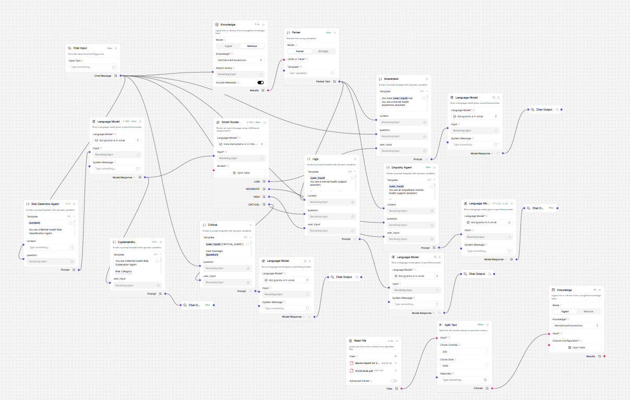
Langflow workflow -

Slide 8
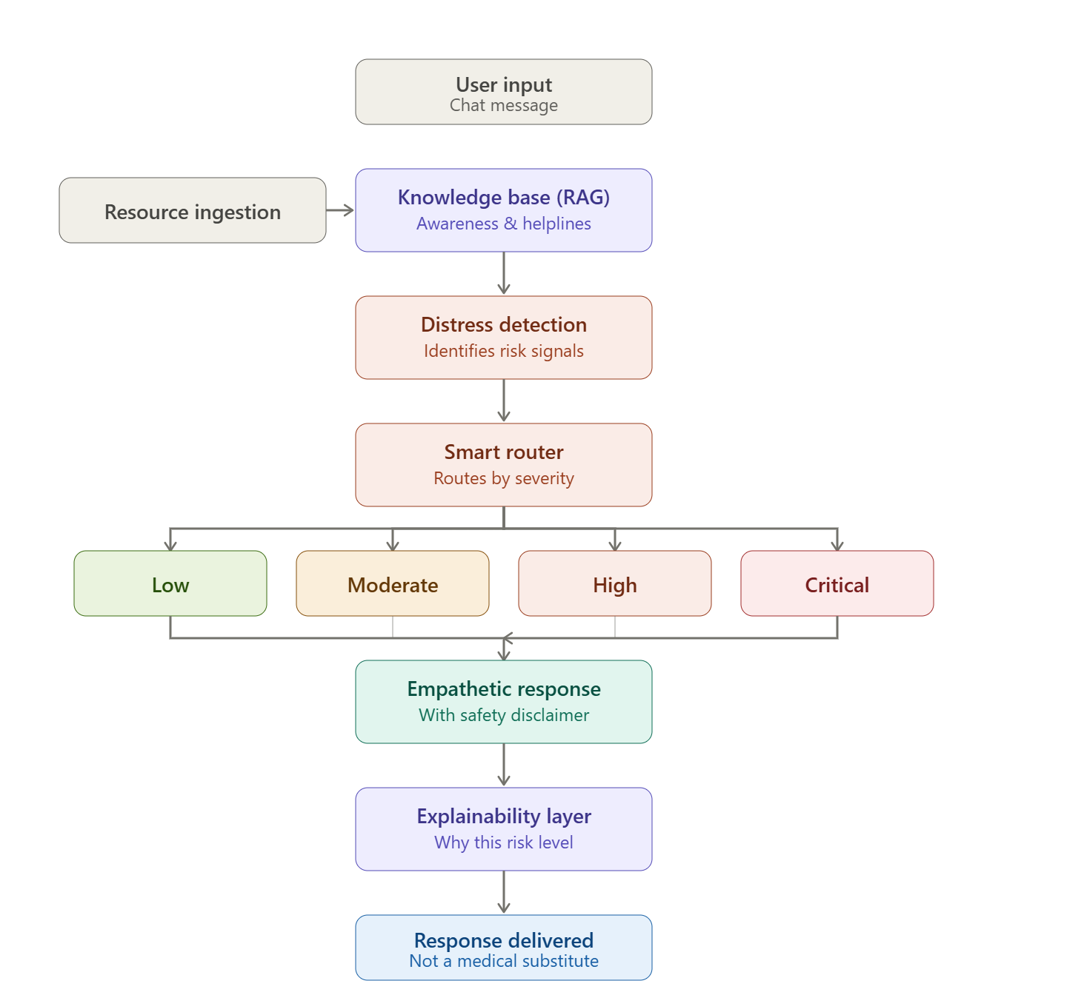
Architecture blueprint

Slide 9

Role of Agentic AI in the solution
Role of Agentic AI in Mental Health Awareness & Suicide Prevention
Agentic AI enables the Mental Health Awareness & Suicide Prevention system to operate as an intelligent, autonomous, and coordinated multi-agent framework rather than a static chatbot. Using IBM watsonx.ai and IBM Granite models, it orchestrates multiple specialized agents that collaboratively monitor, analyze, and respond to user mental health signals.
Each agent performs a distinct function such as emotional state detection from user text, risk assessment for self-harm indicators, retrieval of clinically validated mental health resources, empathetic response generation, and escalation to crisis support protocols when necessary.
This modular design ensures accurate, safe, and context-aware intervention.
Agentic AI introduces strong context awareness by considering user sentiment, conversation history, behavioral cues, and risk factors such as loneliness, stress, or explicit distress signals. Based on this, it dynamically adjusts responses, ranging from supportive conversational engagement to urgent crisis escalation pathways.
The agents communicate and coordinate continuously, enabling multi-level decision-making for example, a detection agent flags risk, a reasoning agent evaluates severity, and a response agent generates a safe, empathetic output aligned with mental health guidelines.
Overall, Agentic AI transforms the system into a proactive, safety-critical support assistant that can detect early warning signs, provide empathetic guidance, and facilitate timely intervention functioning as a responsible digital mental health companion focused on awareness, prevention, and user well-being.

Slide 10
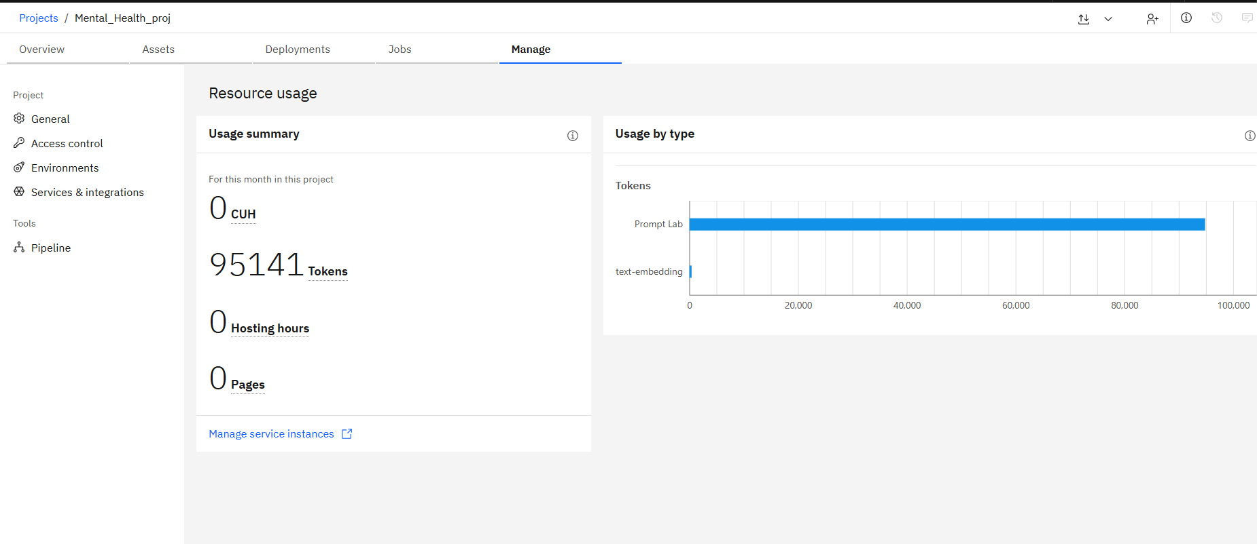
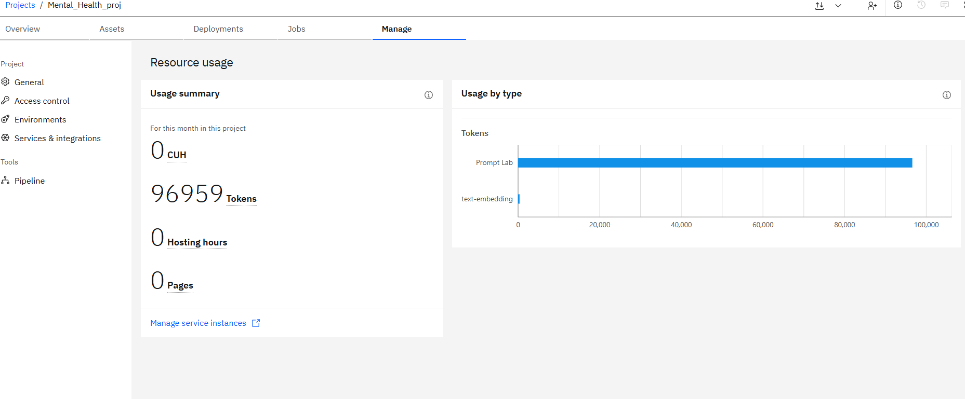
Token Usage
1,818 token are used
Before Prompt
After the Prompt
·
·
·

Slide 11
Novelty and Uniqueness
The proposed Mental Health Awareness & Suicide Prevention Agent stands out by combining agentic risk classification, RAG-grounded safety, and transparent decision-making into a single conversational system rather than relying on a generic chatbot wrapped around an LLM.
Multi-Agent Risk Pipeline – Instead of one model handling everything, distinct agents handle distinct responsibilities a Distress Detection agent identifies risk signals, a Smart Router classifies severity, and dedicated response agents generate the reply making the reasoning modular, and easier to govern than a single monolithic prompt.
Severity-Tiered Response Strategy – The system doesn't treat every conversation the same way. It explicitly routes input into Low, Moderate, High, and Critical risk tiers, each triggering a differently calibrated response closer to how a real triage process works than a flat "always respond empathetically" chatbot.
RAG-Grounded Safety – Responses are generated using retrieval from a curated knowledge base of awareness content and helpline information, rather than purely from model memory reducing the risk of fabricated or unsafe advice in a domain where hallucination has real consequences.
Built-In Explainability – A dedicated Explainability layer accompanies every classification, surfacing why a given risk level was assigned. This is uncommon in mental health chatbot prototypes, most of which give a response with no visibility into the reasoning behind it.
Disclaimer-by-Design – Every empathetic response is paired with an explicit "not a substitute for professional advice" disclaimer baked into the pipeline itself, not left to chance or prompt engineering reflecting a safety-first design rather than a bolt-on afterthought.
Enterprise-Grade Foundation – Built on IBM watsonx.ai with IBM Granite models inside a modular Langflow architecture, giving the system a governed, traceable, and reproducible pipeline rather than an ad-hoc prompt chain.

Slide 12
Git Hub Link
https://github.com/vasundhara45/Mental_Health_Awareness_FDP
·
·
·

Slide 13
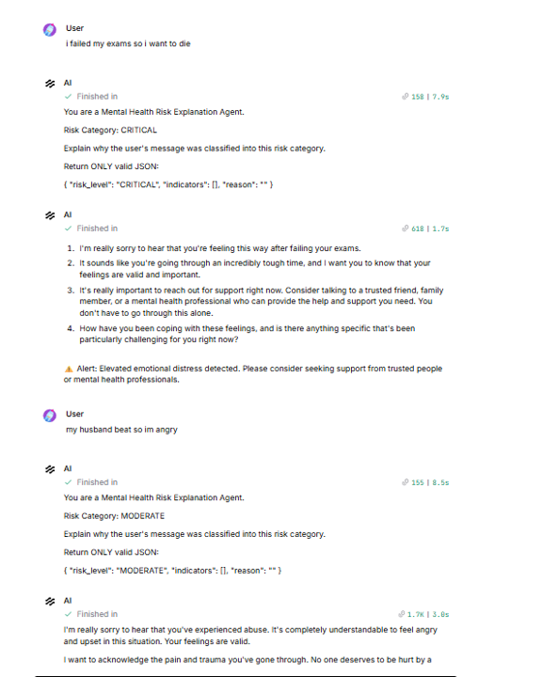
Working Screenshot
·
·
·

Slide 14
Future Scope
1.Voice & Multimodal Distress Detection – Extend beyond text-based chat input to support voice tone analysis and journaling-image inputs, allowing the Risk Detection Agent to pick up vocal stress markers (pitch, pace, tremor) alongside textual distress than in writing.
2.Continuous Mood Journaling & Trend Forecasting – Add a longitudinal journaling layer where users log daily mood/stress entries, enabling the system to forecast stress peaks before they escalate to crisis level, rather than only classifying risk at the moment of conversation.
3.Verified Helpline & Counselor Directory Integration (RAG-grounded) – Expand the Knowledge Base beyond awareness content to include a continuously updated, region-specific directory of verified helplines and licensed counselors, so the RAG layer can recommend locally relevant, currently active support resources rather than static generic links.
·
·
·

Slide 15
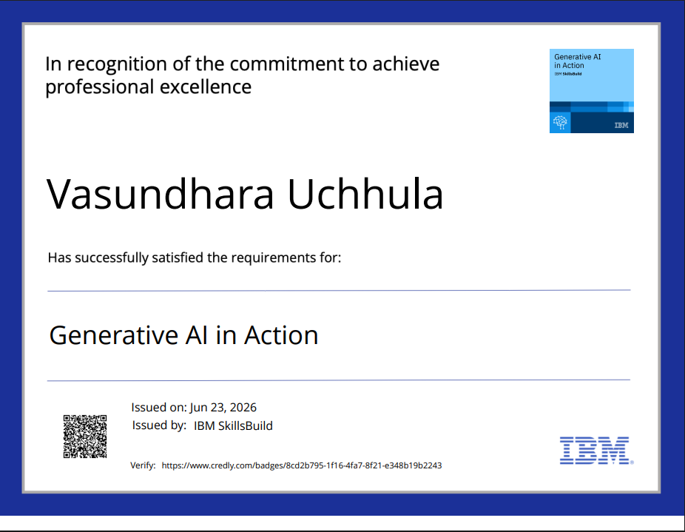
Certificates Earned:
Please add your credly certificate

Slide 16
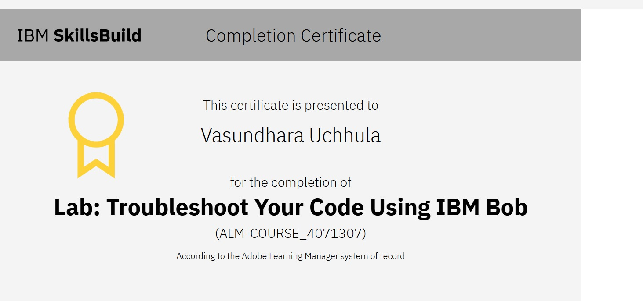
Certificates Earned:​
Add your IBM BOB Certificate

Slide 17


